Slide 1
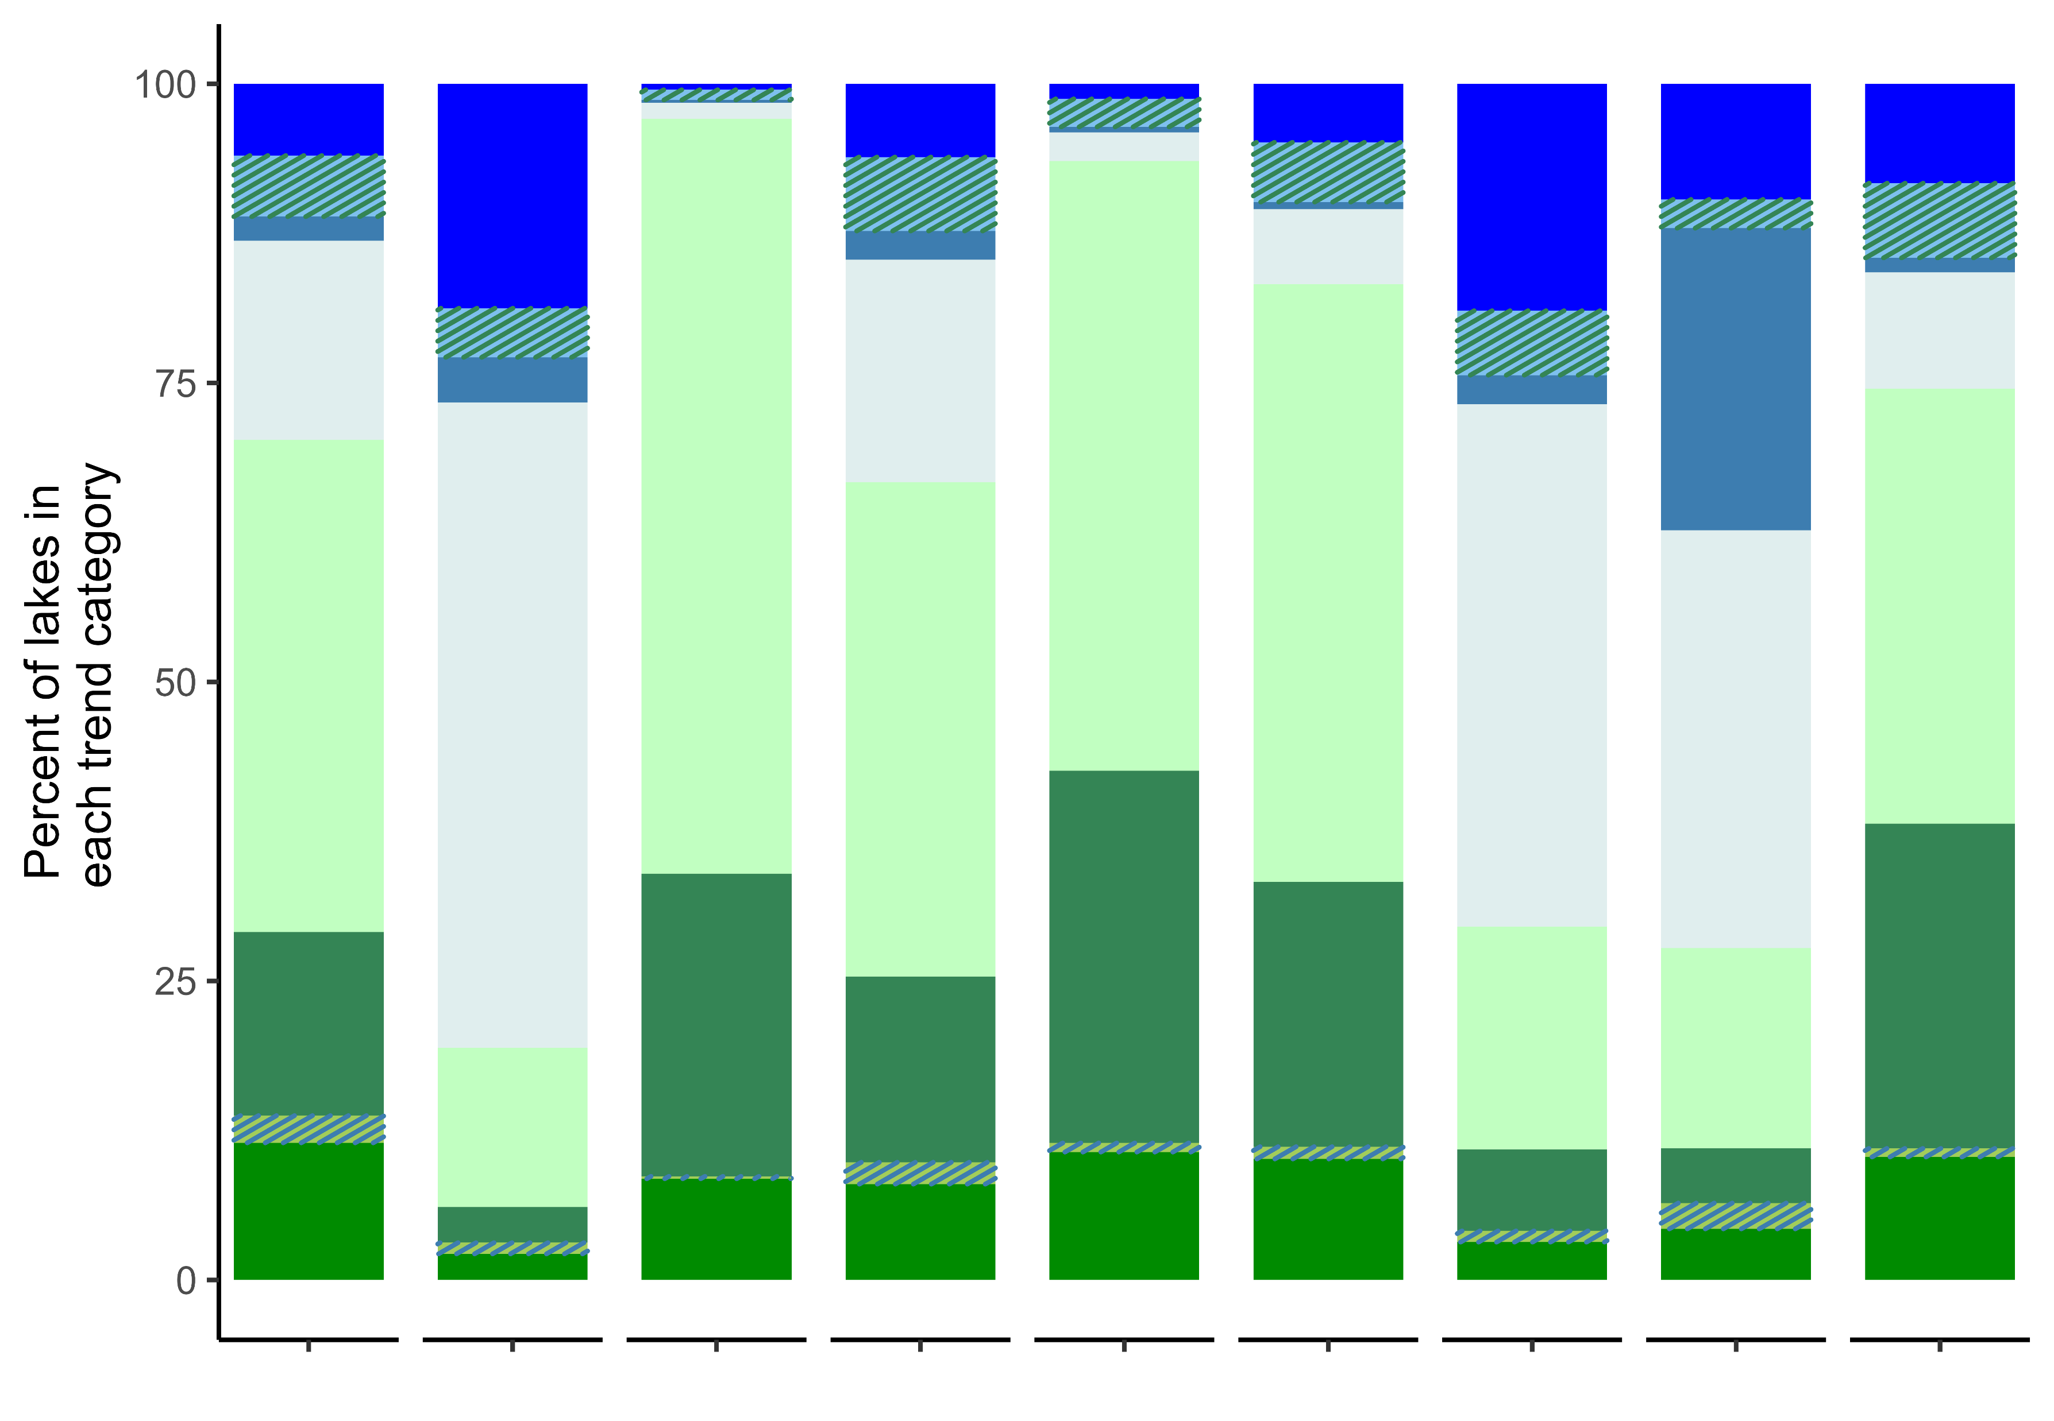
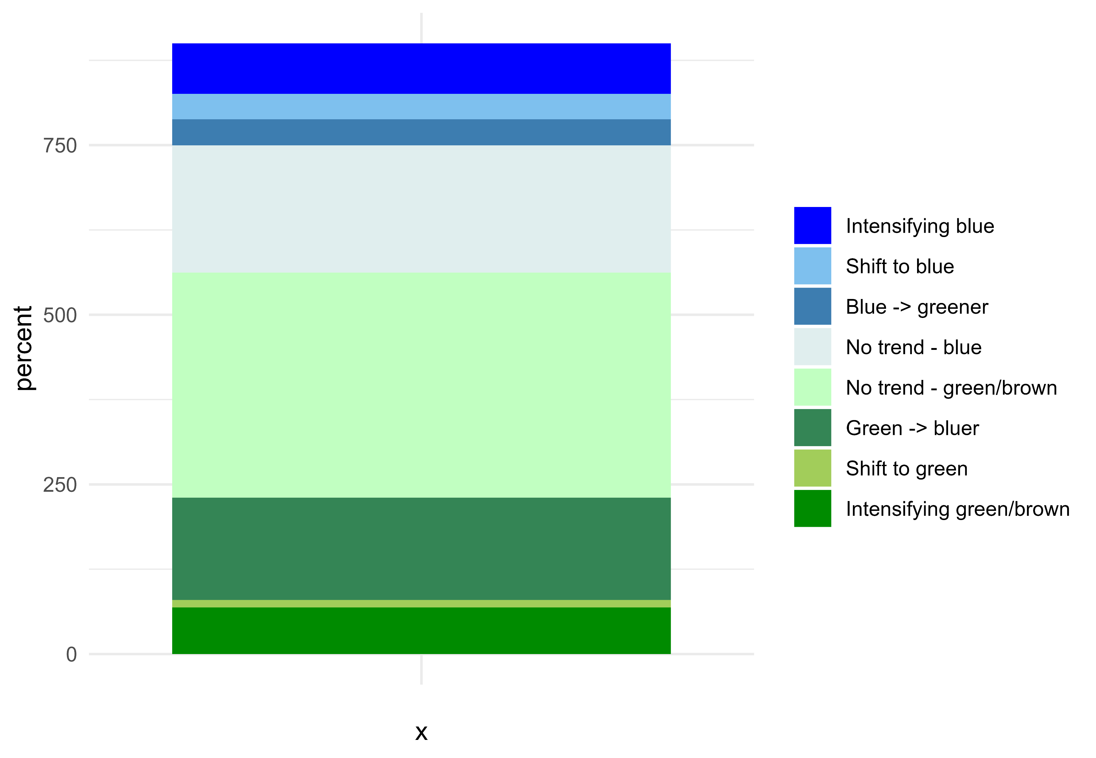


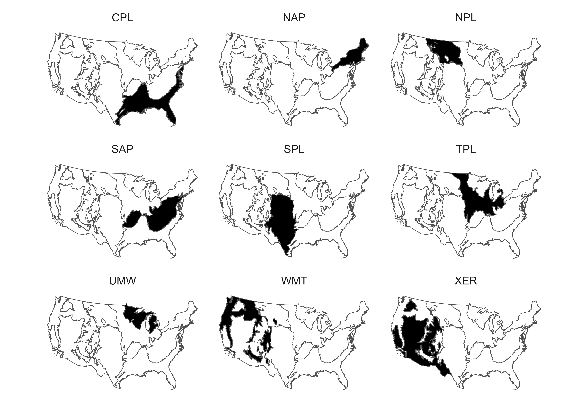


Coastal Plains
Northern Plains
Southern Appalachians
Southern Plains
Temperate Plains
Upper Midwest
Western Mountains
Xeric
Northern Appalachians

Slide 2
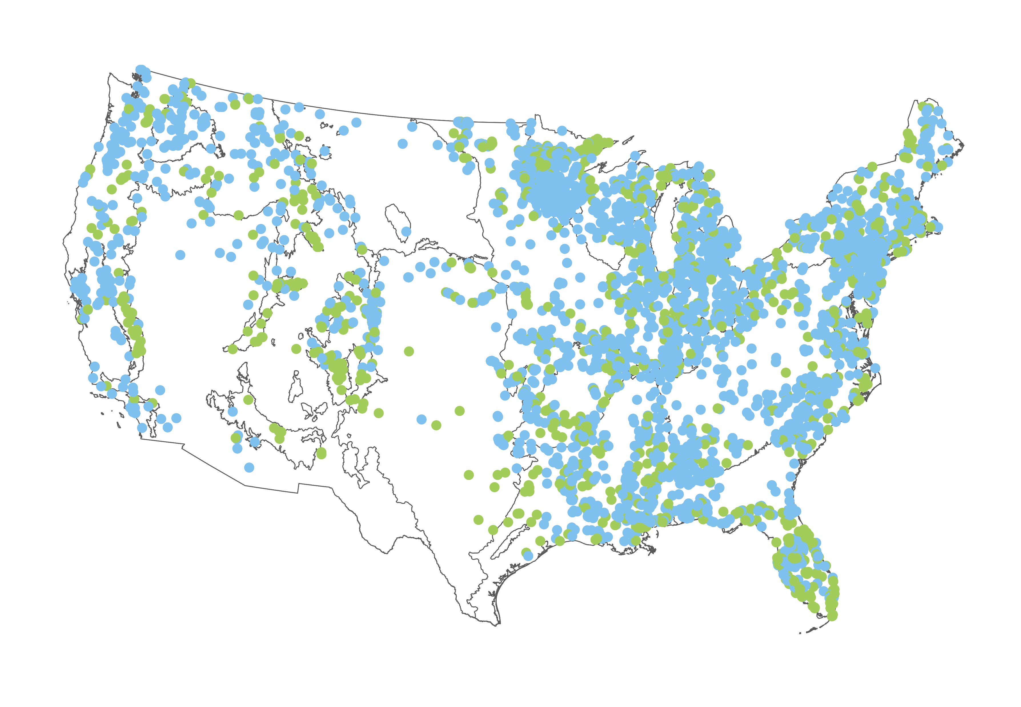
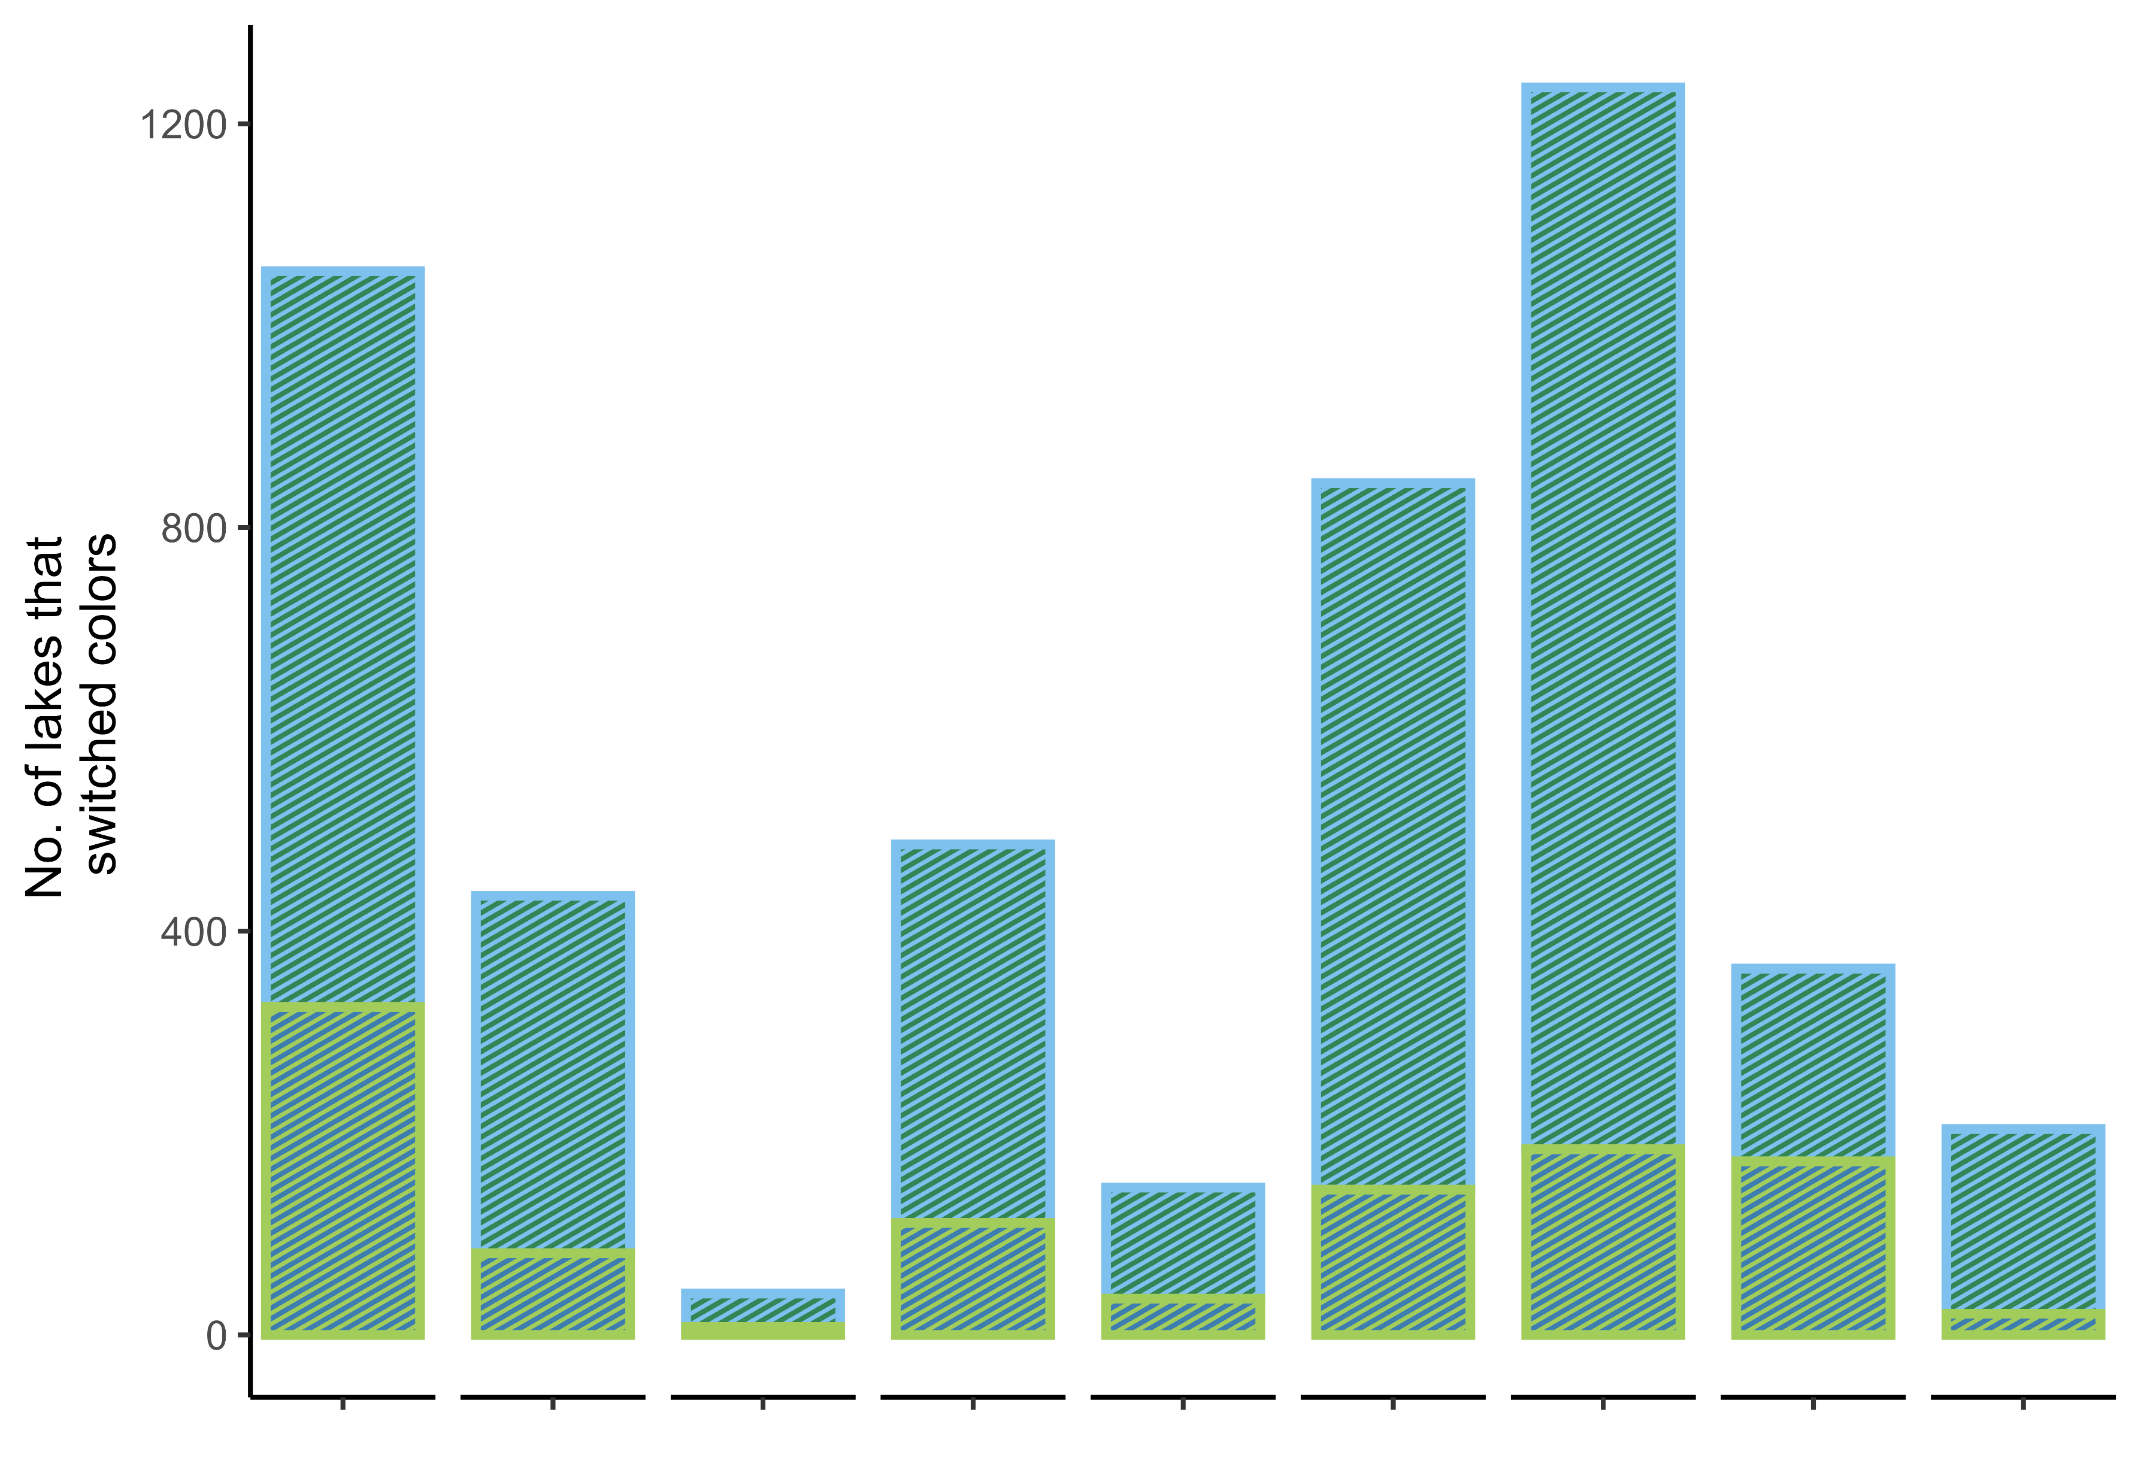
Coastal Plains
Northern Plains
Southern Appalachians
Southern Plains
Temperate Plains
Upper Midwest
Western Mountains
Xeric
Northern Appalachians

Slide 3


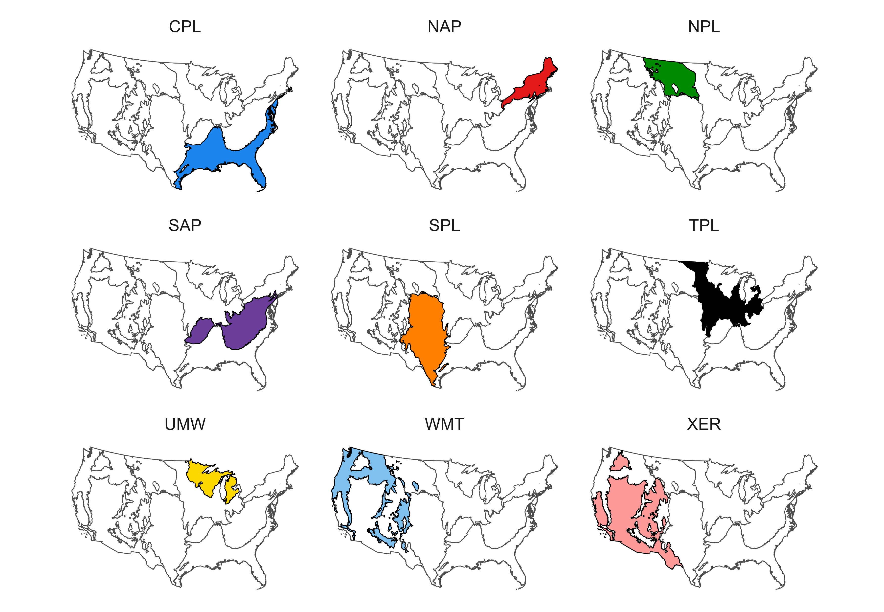

Slide 4
